Slide 1
Scatcom
-By Distributed Slingers

Slide 2
Need for distributed computing:
Computation power is a major limitation for a user with normal a system.
It’s not possible for everyone to afford computers with heavy computations.
It can multifold the existing computation limits of even a super computer.
Many algorithms teks hours to execute which xca be reduced by using distributing its operational load.

Slide 3
What our HACK do?

Slide 4
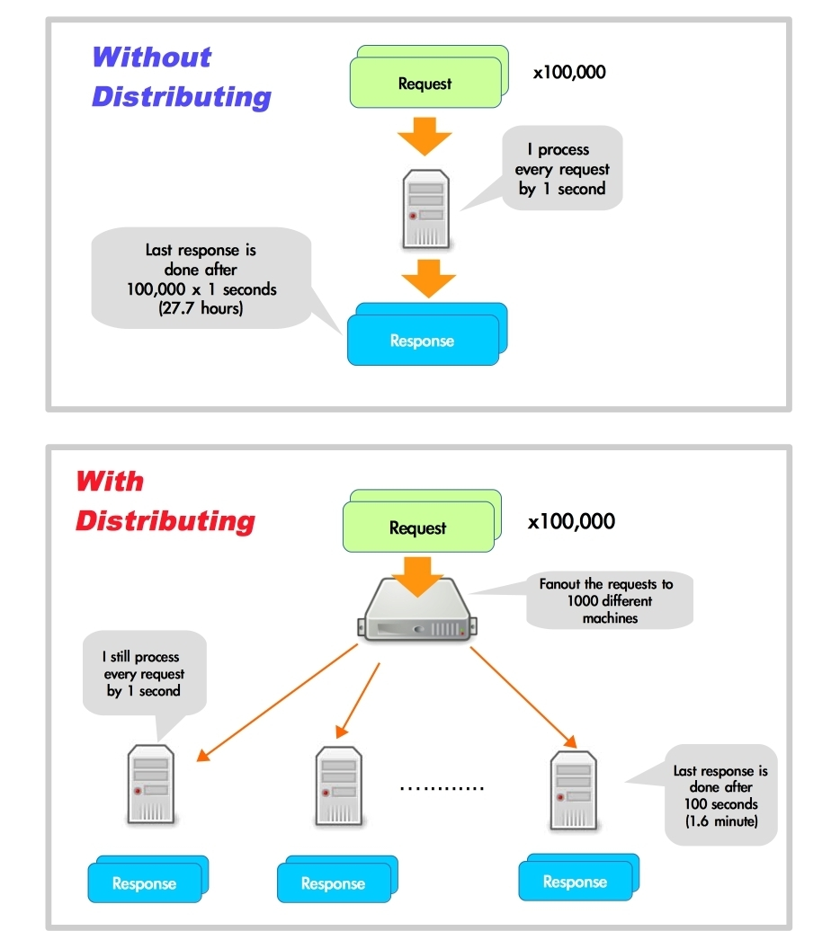
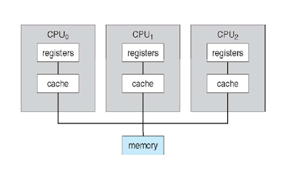

Slide 5

Number of iteration for 1000*1000 image are approximately 10^9.

Slide 6
Possibilities?

Slide 7
Thank You

